Slide 1
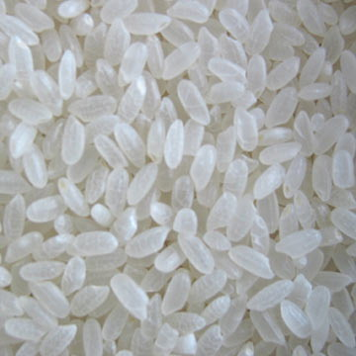
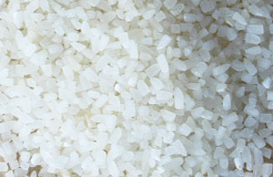
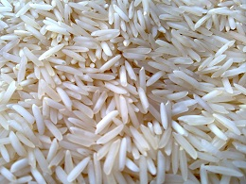
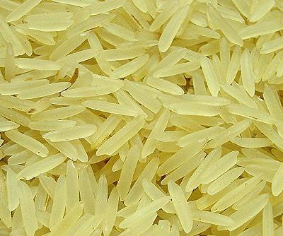
An Overview of Rgsl Agro, India
www.rgslagro.com

Slide 2
About Us
We are a team of experienced professionals in the field of “International Agro Product Trading” with specialization in offering Rice for Exports from India.
Our strength lies in:-
Updating customer on regular commodity price movement, currency fluctuations, Government policies, Sea Freight movement enabling buyer to take firm purchase decisions.
Serving customer specific need on Quality, Packaging, Branding, Rice Variety and other required standards.
Timely Shipment deliveries (whether on Ex-factory, FOR, FOB, CIF terms).
Offering best competitive price & handling big volume business.
www.rgslagro.com

Slide 3
Our Vision & Mission
Our Vision: To feed the World with quality agro products most economically.
Our Mission: Selling highest quality agro products from every part of World to every part of the World with 100% customer satisfaction.
www.rgslagro.com

Slide 4
About Indian Rice Trade
India is expected to share 28% of Global rice trade of 38 million tons (approx) this year to become number one World rice exporter.
Indian Rice exports projection is 11 million tons for year 2013-2014. In 11 million tons, Basmati rice exports are expected 3.5 million tons & 7.5 million tons from Non Basmati rice.
In terms of value, rice exports are expected to touch figure of $6.5 billion in year 2013-14.
www.rgslagro.com

Slide 5
ProductS We oFfer
We Offer a wide range of Indian Origin Rice grades as per Country specific customer needs, Branding, Packaging etc requirements. Our Product Range is broadly categorized into two rice Grades which we offer in different forms like Brown, Raw, Parboiled, Steamed etc:-
Basmati Rice:-
Traditional Basmati Rice 1121 Basmati Rice
PUSA Basmati Rice Sughanda Basmati Rice
Blended Basmati Rice
Non Basmati Rice:-
Long Grain Rice Short Grain Rice
Medium Grain Rice 100% Broken Rice
www.rgslagro.com

Slide 6
Basmati Rice
We offer Basmati Rice grades in customer required Packaging (like 1 Kg pouch, 1 Kg Jar, 2 Kg pouch, 2 Kg Jar, 5 Kg Bag, 10 Kg Bag, 40 Kg Bag, 50 Kg Bag etc), Quality (SGS) standards, Branding.
Traditional Basmati Rice (Availability: Raw, Parboiled & Steamed option)
1121 Basmati Rice (Availability: Raw, Parboiled & Steamed option)
PUSA Basmati Rice (Availability: Raw, Parboiled & Steamed option)
Sughanda Basmati Rice (Availability: Raw, Parboiled & Steamed option)
Blended Basmati Rice (Availability: Raw, Parboiled & Steamed option)
(Please note: Above mention rice varieties are most common varieties for Exports today, we are in position to offer all Indian rice varieties against specific requirements.)
www.rgslagro.com

Slide 7
Non-Basmati Rice
We offer Indian Non-Basmati Rice grades in customer required Packaging (like 25 Kg , 40 Kg, 50 Kg, 100 Kg PP or Jute Bags), Quality (SGS) standards, Branding. Few of the most common Indian Non Basmati rice exports varieties are:
IR-8 Rice Swarna Rice
PR-11 Rice PR-14 Rice
100% Broken Rice Long Grain Rice
Short Grain Rice Medium Grain Rice
Sona Massuri Rice Massuri Rice
(Please note: Above mention rice varieties are most common varieties for Exports today, we are in position to offer all Indian rice varieties against specific requirements.)
www.rgslagro.com

Slide 8
Why choose US ?
A team of experienced players in both International & Domestic Rice trade.
Competitive prices, Quality products & Services.
Have Quality Experience in serving Big International clients as per their specific packaging & Branding needs.
Capability of handling big volume business.
Timely deliveries as per required shipment terms.
www.rgslagro.com

Slide 9
Thank you for you valuable time & we look forward for your valuable inquiries.
Best Regards,
Rgsl Agro Team,
Rgsl Agro, Plot No. 28, 2nd Floor, Sector - 3A, Vaishali, Ghaziabad - 201010, U.P., India Ph: 0120 - 4107708, +91 - 9717799006 Email: rahul@rgslagro.com Website: www.rgslagro.com
www.rgslagro.com

